Slide 1
IILM
UNIVERSITY
GREATER NOIDA
INTERNSHIP PRESENTATION
House Price Prediction Using Machine Learning
Data Science Master Virtual Internship
PRAMOD KUMAR
IILM University, Greater Noida
Enrollment / Roll No.: 2410030367
Organization / Supporting Organization: Siemens
B.Tech Computer Science & Engineering • 2nd Year
April – June 2026 • 8 Weeks

Slide 2
Internship Overview
PROGRAMME
DURATION
DOMAIN
Data Science Master
April – June 2026
Siemens Data Science Master
8-week virtual internship
Structured weekly learning & assessment
AICTE – EduSkills Virtual Internship
Internship Learning Structure
Internship Evidence
• Applications & Use Cases
• Data Engineering Professional
• Machine Learning Professional
• Data Preparation Master
• Machine Learning Master
• ML Deployment & Monitoring
• Platform Administration Master
• Internship offer letter
• Virtual internship completion certificate
• Project implementation: House Price Prediction
• Final model comparison and evaluation
IILM University • Data Science Master Virtual Internship
2

Slide 3
Problem Statement & Objectives
Key Objectives
PROBLEM STATEMENT
• Prepare and clean a large housing dataset.
• Handle missing values and numerical outliers.
• Encode categorical features and standardize inputs.
• Train and compare six regression models.
• Evaluate models using R², MAE and RMSE.
• Select the best-performing model for the dataset.
House prices depend on multiple numerical and categorical factors. Manual estimation becomes difficult when many property attributes must be considered together. The project develops a regression-based machine learning system to predict Price_in_Lakhs from historical Indian housing data.
IILM University • Data Science Master Virtual Internship
3

Slide 4
Dataset & Data Preparation
RECORDS
COLUMNS
TARGET
AFTER IQR
250,000
23
Price_in_Lakhs
229,980
Original property records
Original dataset columns
Regression target
Records after outlier filtering
Preprocessing Pipeline
Final Split
• Dataset inspection using Pandas
• Missing-value analysis
• Median/mode-based preprocessing
• IQR-based numerical outlier removal
• Categorical encoding
• Feature scaling with StandardScaler
• 80:20 train-test split
TRAINING SET
183,984 samples
80% of processed data
TEST SET
45,996 samples
20% of processed data
IILM University • Data Science Master Virtual Internship
4

Slide 5
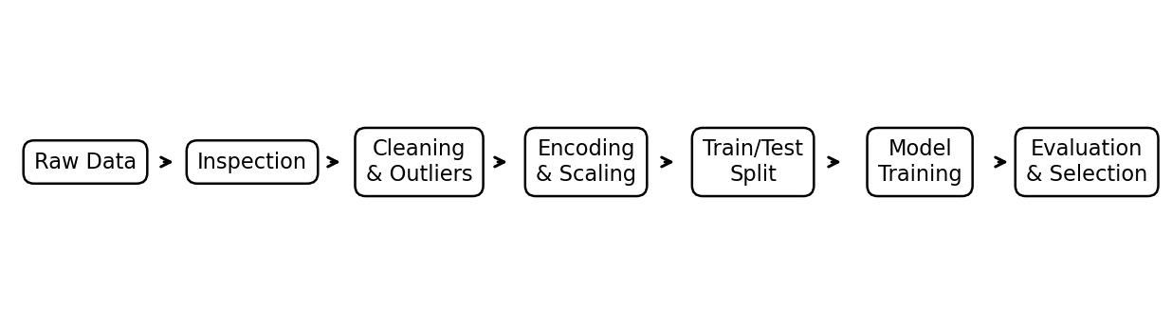
Machine Learning Architecture
End-to-end workflow: data → preprocessing → model training → evaluation → model selection
PREPROCESSING
MODELLING
EVALUATION
Clean + Encode + Scale
6 Regression Models
R² + MAE + RMSE
Prepare model-ready features
Train and compare algorithms
Select the strongest model
IILM University • Data Science Master Virtual Internship
5

Slide 6
Machine Learning Models Used
Linear Regression
Ridge Regression
Lasso Regression
Baseline linear model
L2 regularization
L1 regularization
Decision Tree
Random Forest
Gradient Boosting
Tree-based regression
Ensemble of decision trees
Sequential boosting model
Model selection is based on performance on the held-out test set.
IILM University • Data Science Master Virtual Internship
6

Slide 7
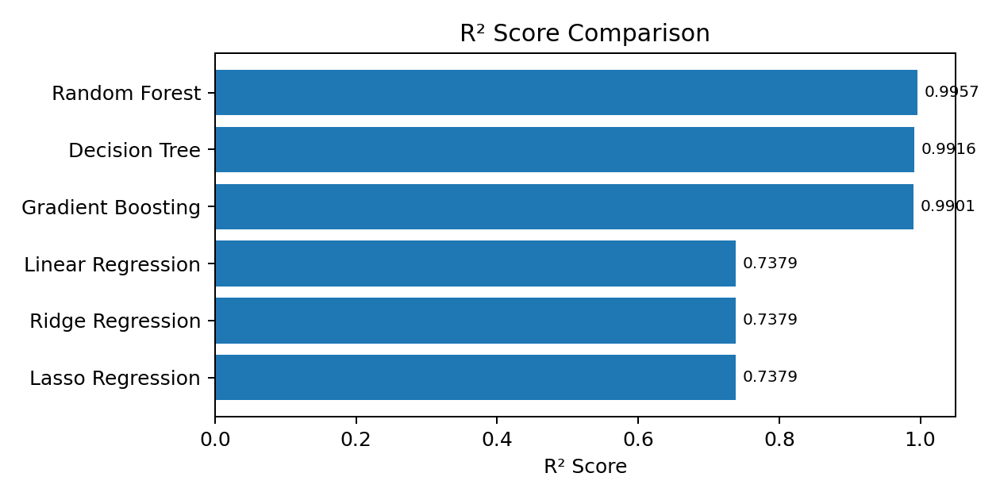
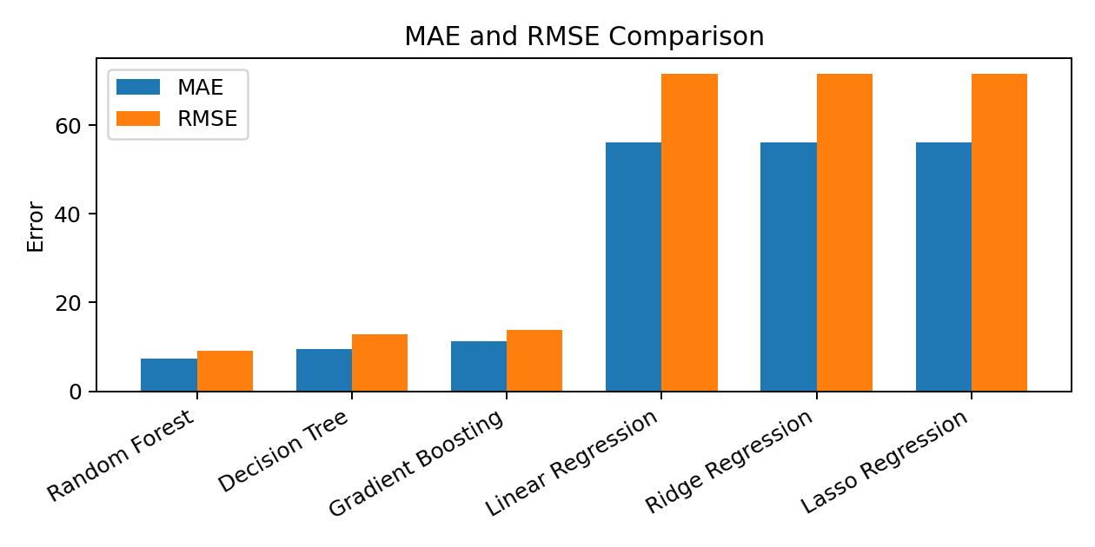
Model Performance
Higher R² is better • Lower MAE/RMSE is better
IILM University • Data Science Master Virtual Internship
7

Slide 8
BEST PERFORMING MODEL
Random Forest
Strongest performance on the recorded test split
R² SCORE
MAE
RMSE
0.9957
7.26
9.20
Highest among tested models
Lowest recorded error
Lowest recorded RMSE
Why Random Forest?
• Captures non-linear relationships
• Combines multiple decision trees
• Strong predictive performance on this dataset
IILM University • Data Science Master Virtual Internship
8

Slide 9
Key Findings & Learning Outcomes
Project Findings
Skills Developed
• Data preprocessing is essential before model training.
• Outlier treatment reduced the dataset to 229,980 records.
• Tree-based models performed better than the tested linear baselines.
• Random Forest achieved the strongest overall test performance.
• Evaluation metrics provide an objective basis for model selection.
• Python and Pandas-based data handling
• Data cleaning and feature preparation
• Machine learning regression
• Model evaluation and comparison
• Data visualization and result interpretation
• Technical documentation and presentation
IILM University • Data Science Master Virtual Internship
9

Slide 10
Future Scope
DEPLOYMENT
OPTIMIZATION
EXPLAINABILITY
Web Application
Hyperparameter Tuning
Explainable AI
Allow users to enter property details and receive predictions.
Improve generalization and model robustness.
Show which property features influence predictions.
LIVE DATA
MONITORING
UX
Data Integration
Model Monitoring
User-Friendly Interface
Use updated real-estate datasets for continuous improvement.
Track drift and prediction quality after deployment.
Build a simple interface for practical use.
The current project provides a strong foundation for a deployable house-price prediction system.
IILM University • Data Science Master Virtual Internship
10

Slide 11
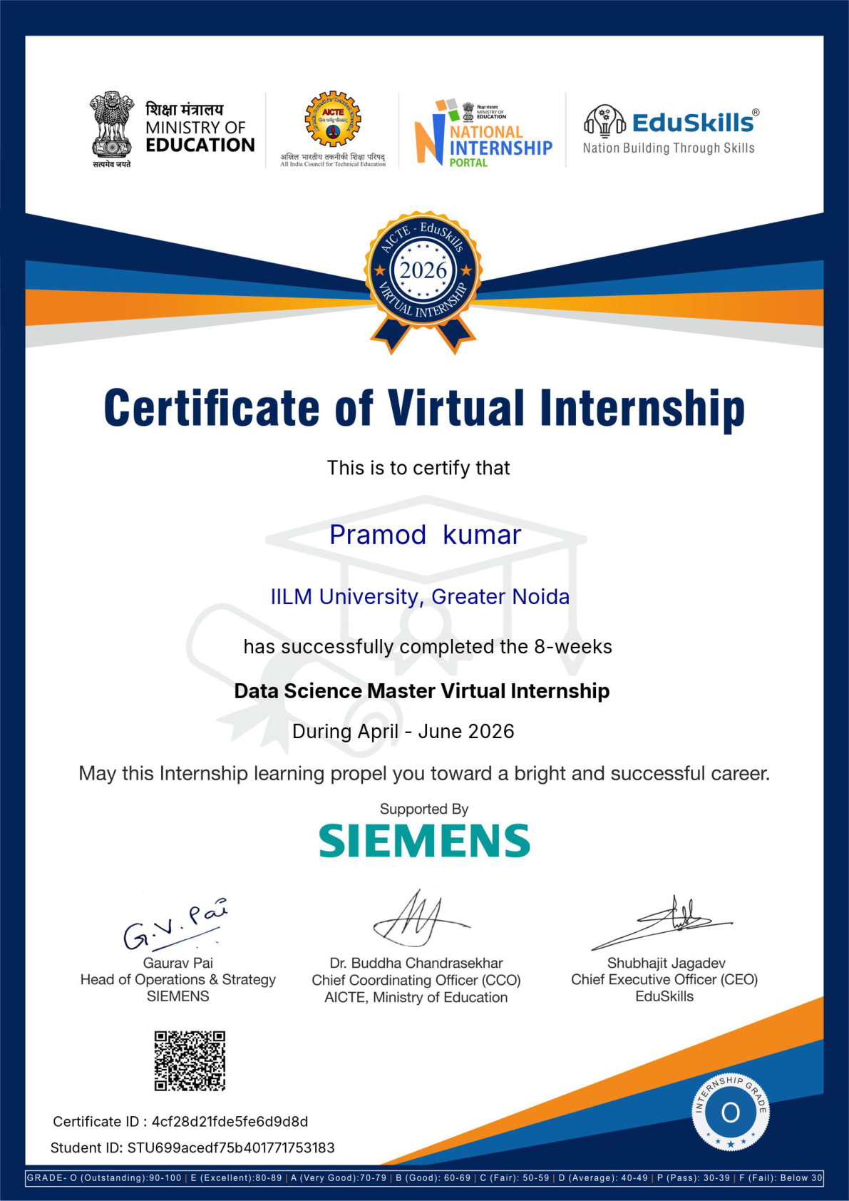
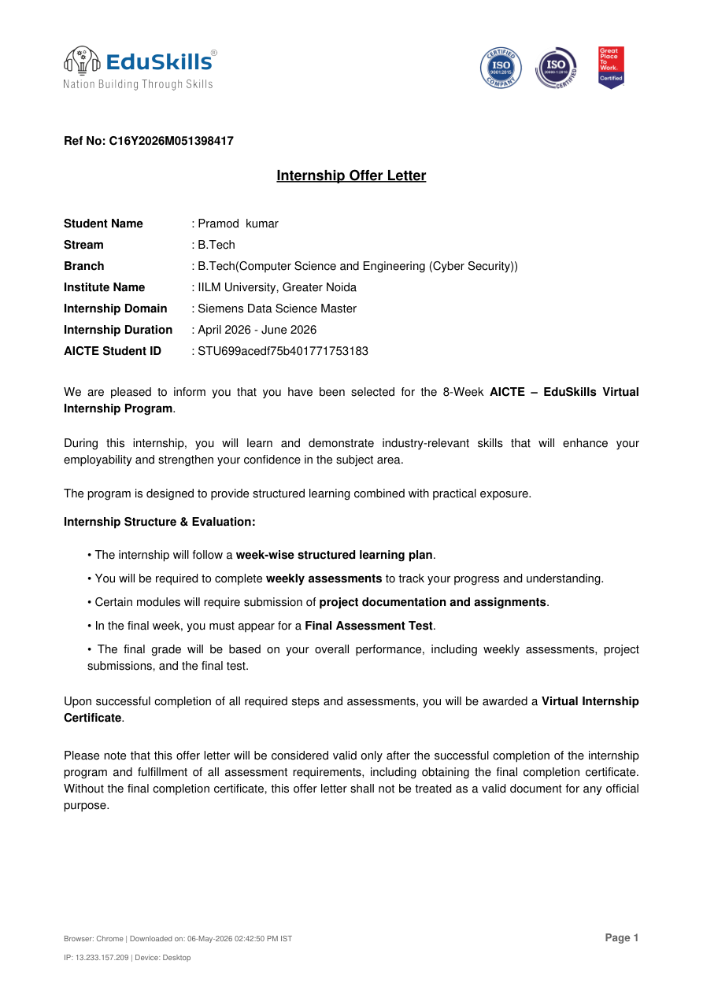
Internship Evidence
Completion Certificate
Internship Offer Letter
IILM University • Data Science Master Virtual Internship
11

Slide 12
IILM
UNIVERSITY
GREATER NOIDA
THANK YOU
House Price Prediction Using Machine Learning
PRAMOD KUMAR • Roll No. 2410030367
pramod.kumar.cs28@iilm.edu
IILM University, Greater Noida
Data Science Master Virtual Internship • April – June 2026

